Slide 1
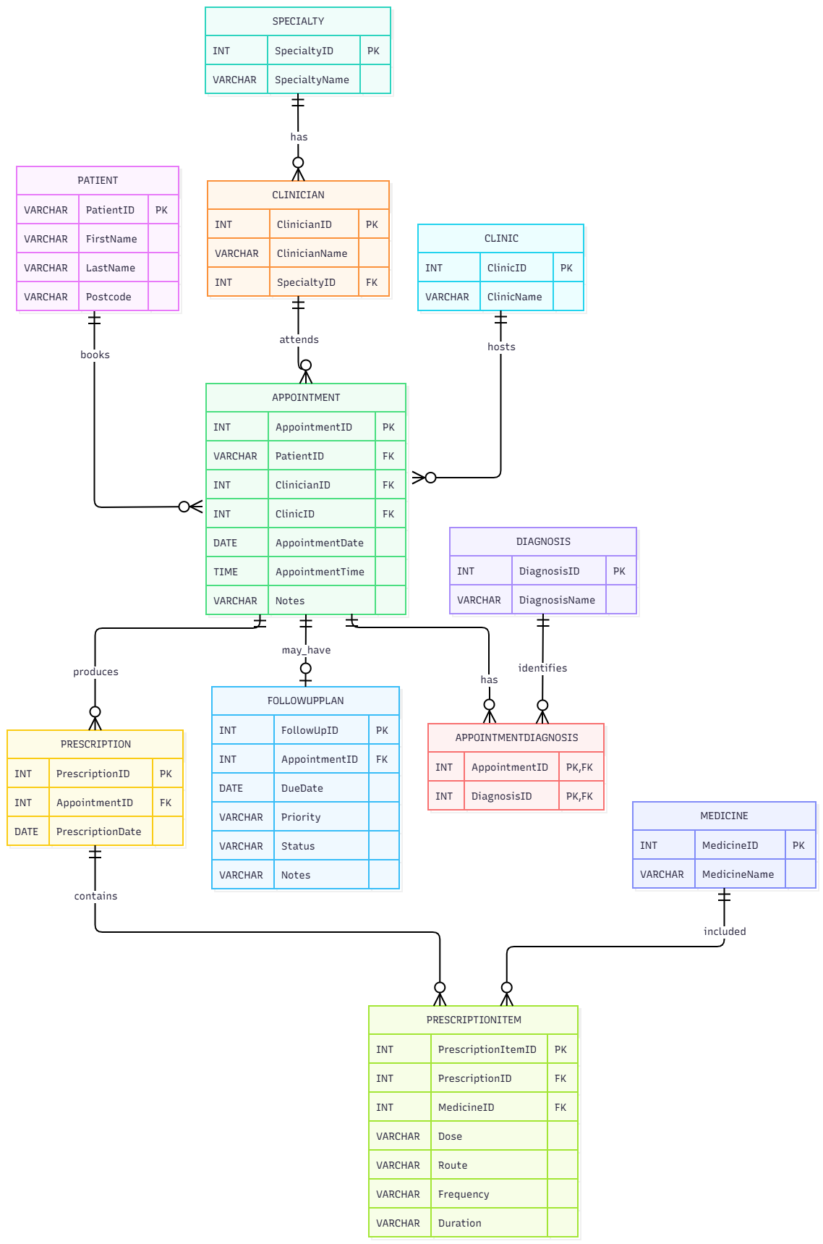
Crownfield Eye Hospital | Database Project
• CPU4:103 – Introduction to Database
• Student 1 – individual presentation
• My focus: tables and ER diagram relationships
• Fictional patient data only
Notes:
Hello. This is my individual presentation on the Crownfield Eye Hospital database project. We worked in a group of three, using fictional patient records only. My main contribution was identifying the entities, attributes and relationships for the ER diagram. I will explain our design and normalisation, and show SQL, security and transaction evidence from the project. I will distinguish my own contribution from group testing.

Slide 2
My individual contribution
• Identified the main entities and attributes
• Helped choose primary and foreign keys
• Drew one-to-many and many-to-many links
• ER diagram and normalisation were group work
Notes:
Speaker notes
My main contribution was database analysis and design. I helped identify the tables we needed, such as Patient, Appointment, Clinician and Diagnosis. I worked out how the tables connect. One patient may have several appointments, but every appointment belongs to one patient. I also helped explain why AppointmentDiagnosis is needed between Appointment and Diagnosis. All three members worked together on the ER diagram and normalisation.

Slide 3

ER diagram: 11 connected tables
Notes:
This is our eleven-table ER diagram. PatientID is the primary key in Patient and a foreign key in Appointment. The Crow's Foot near Appointment means a patient may have zero or many appointments, while each appointment belongs to exactly one patient. Each appointment has one clinician and one clinic. AppointmentDiagnosis connects appointments and diagnoses, because an appointment can have several diagnoses and a diagnosis can be used in several appointments. PrescriptionItem connects prescriptions and medicines. Our business rule is that a prescription contains one or more items, although a foreign key alone cannot enforce that minimum. FollowUpPlan is optional, with at most one plan per appointment. These relationships guided our SQL table design.

Slide 4
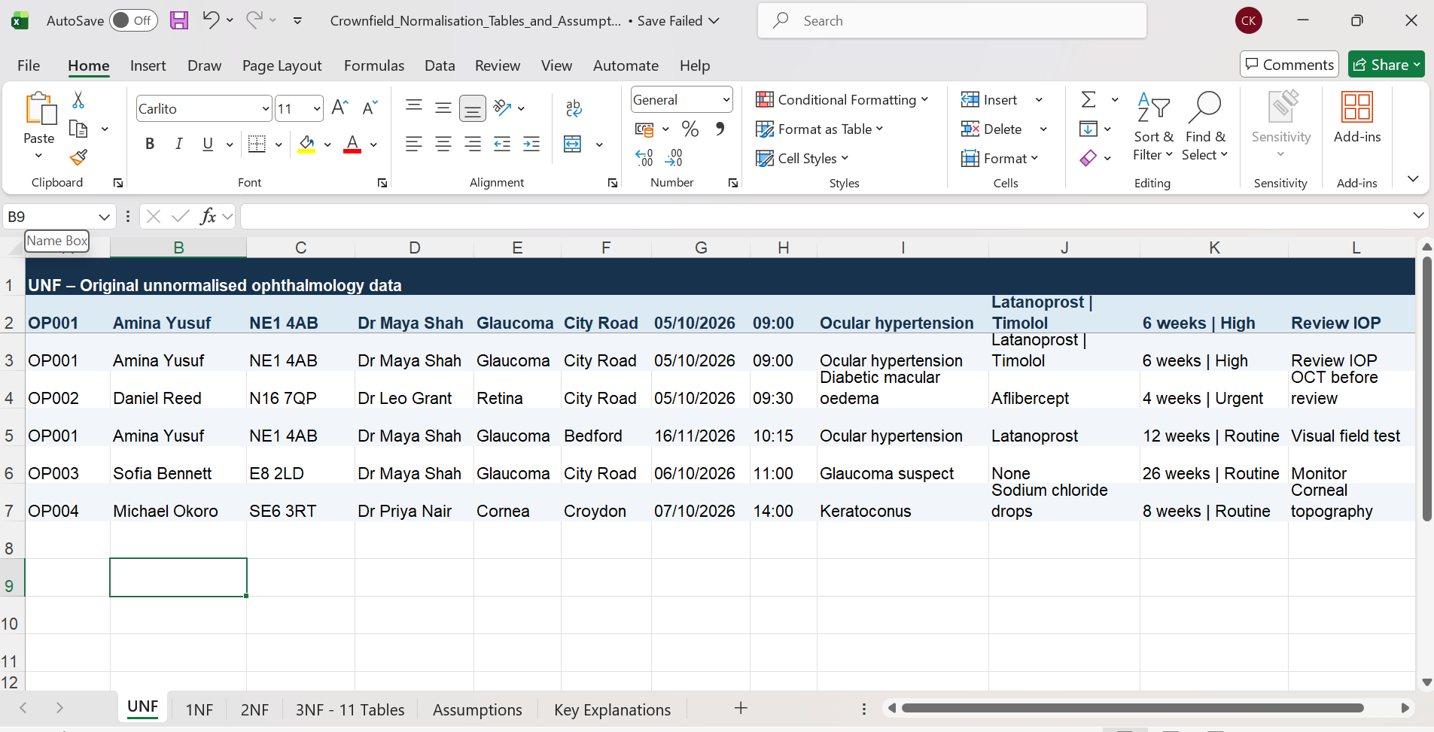
UNF | Original unnormalised data
Notes:
Speaker notes
The original worksheet combines multiple medicines and follow-up information in cells. This causes repeating values and makes updates difficult.

Slide 5
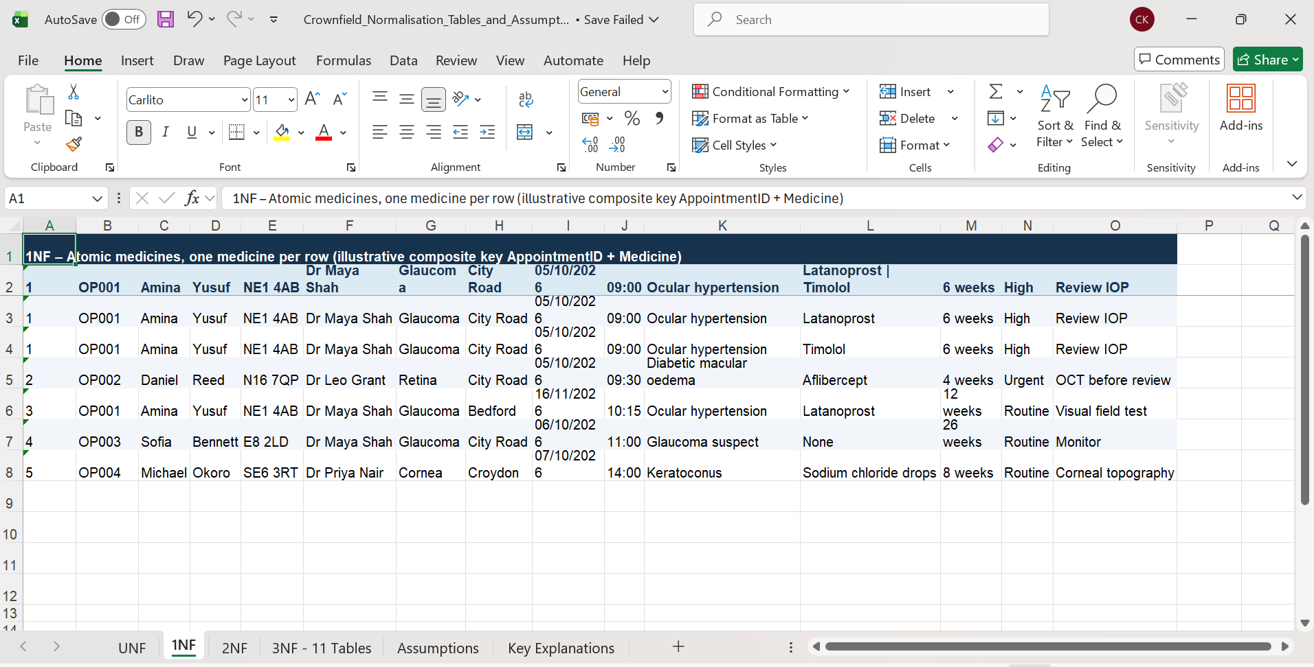
1NF | One value per field
Notes:
Speaker notes
In First Normal Form, the medicines are separated into individual rows and the information is made atomic. The same patient details are still repeated.

Slide 6
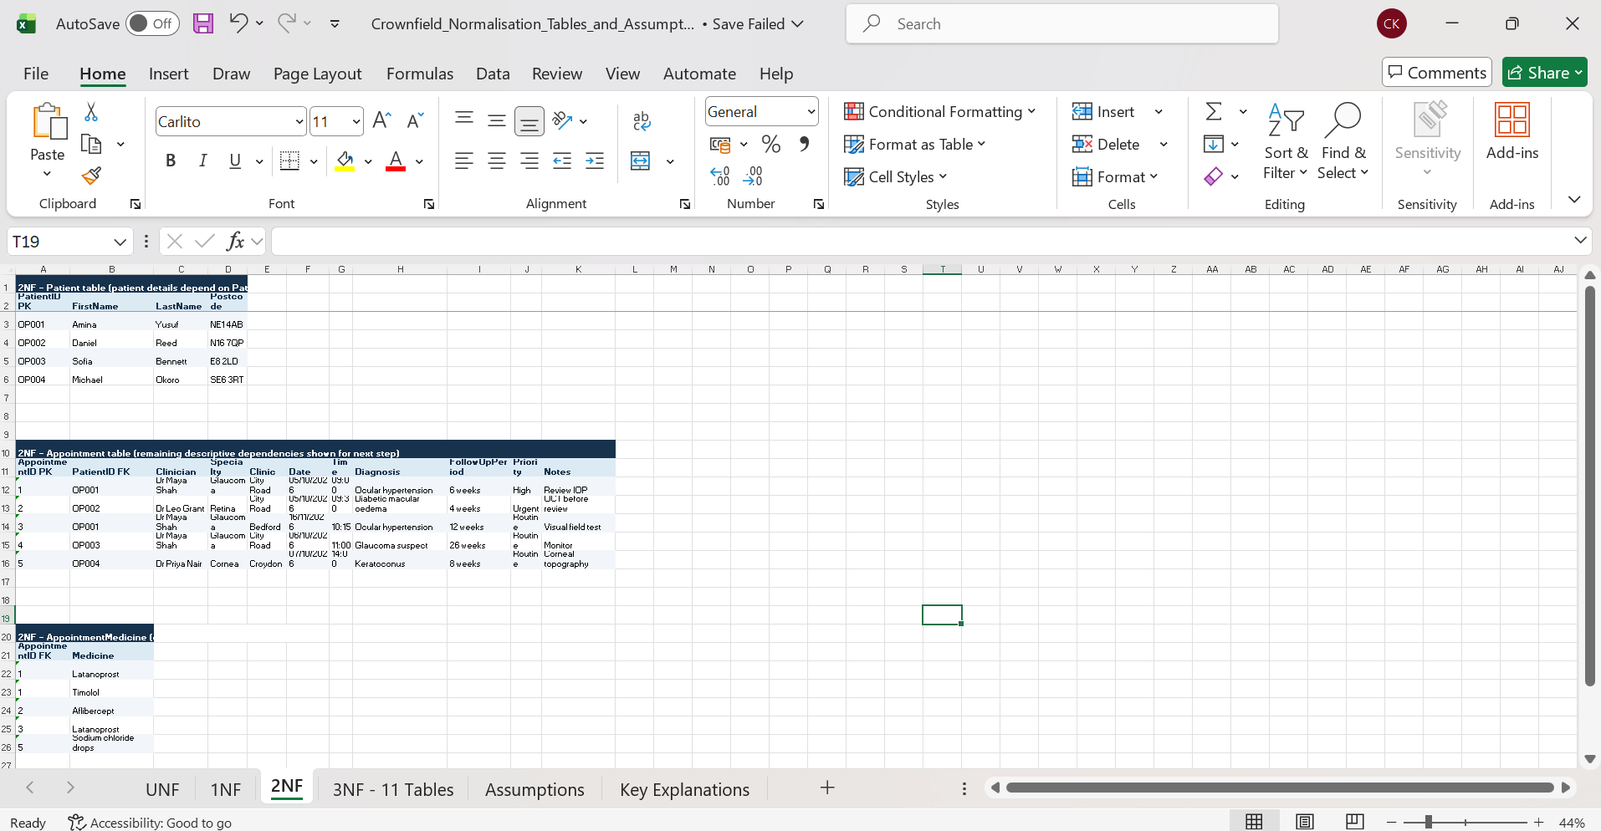
2NF | Remove partial dependencies
Crownfield Eye Hospital • Student 1 • Normalisation evidence
Notes:
Speaker notes
In Second Normal Form, patient details are separated from appointment and medicine information. The worksheet is an illustrative step towards our final database.

Slide 7
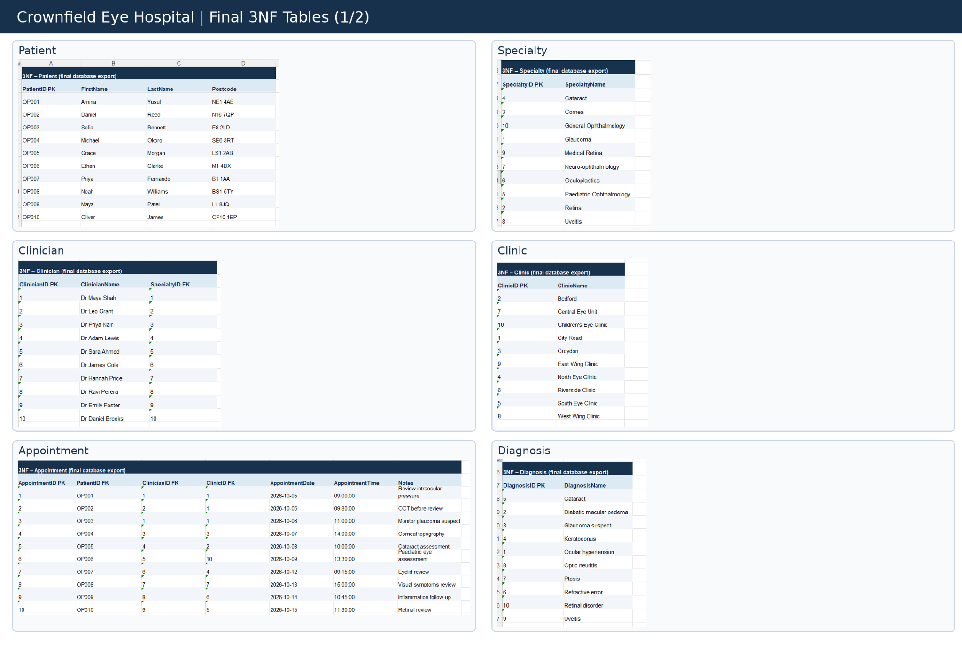
3NF | Final tables (Part 1)
Notes:
Speaker notes
The first part of the final Third Normal Form shows Patient, Specialty, Clinician, Clinic, Appointment and Diagnosis. Each table has a primary key, and related tables use foreign keys.

Slide 8
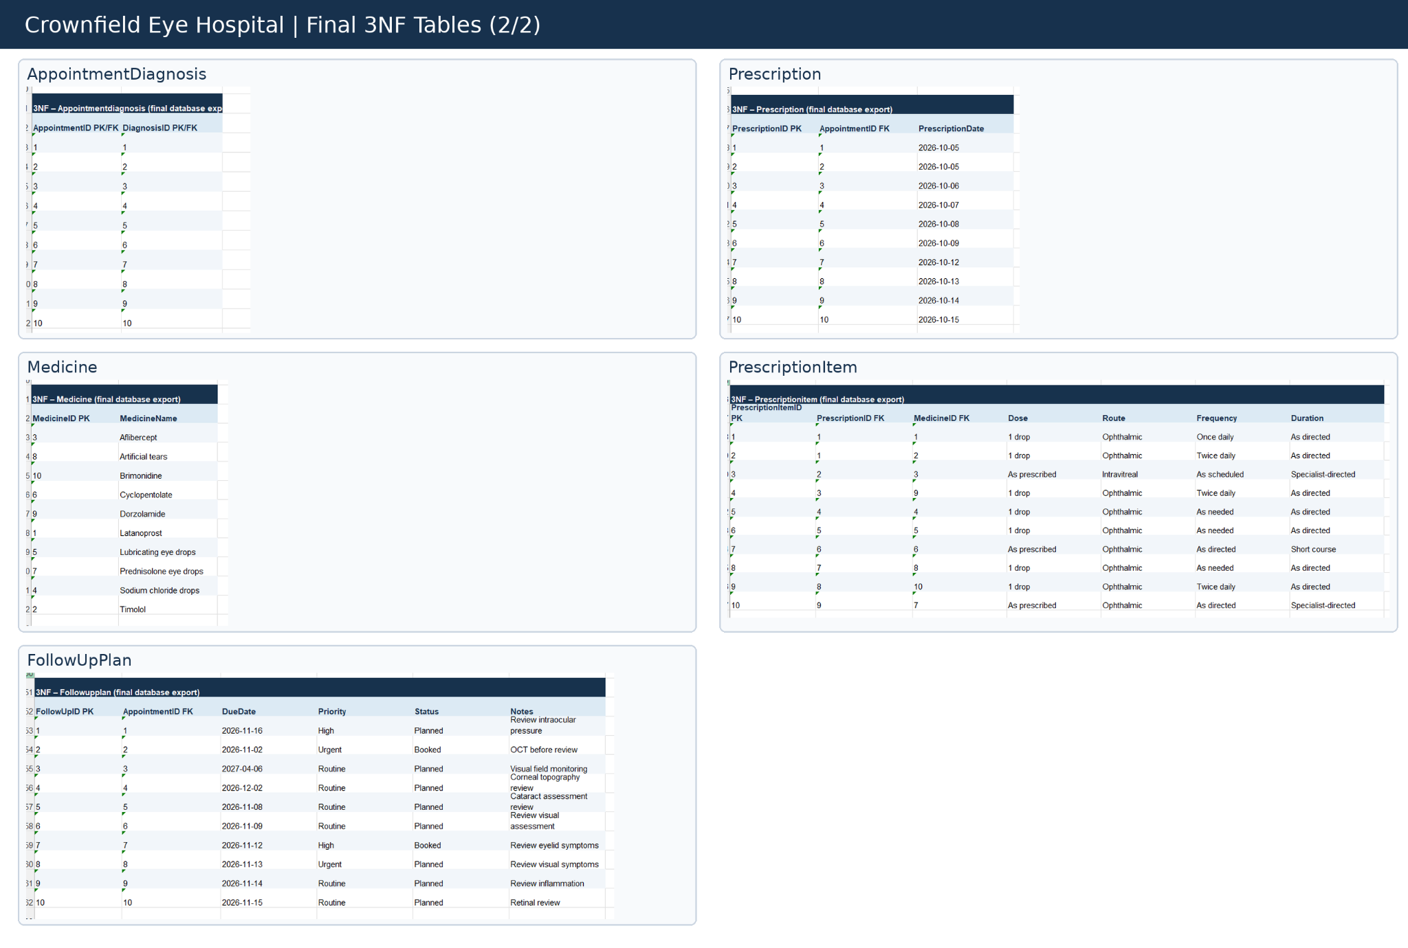
3NF | Final tables (Part 2)
Notes:
Speaker notes
The second part shows AppointmentDiagnosis, Prescription, Medicine, PrescriptionItem and FollowUpPlan. Separating these tables reduces duplicated data and supports the relationships in our ER diagram.

Slide 9
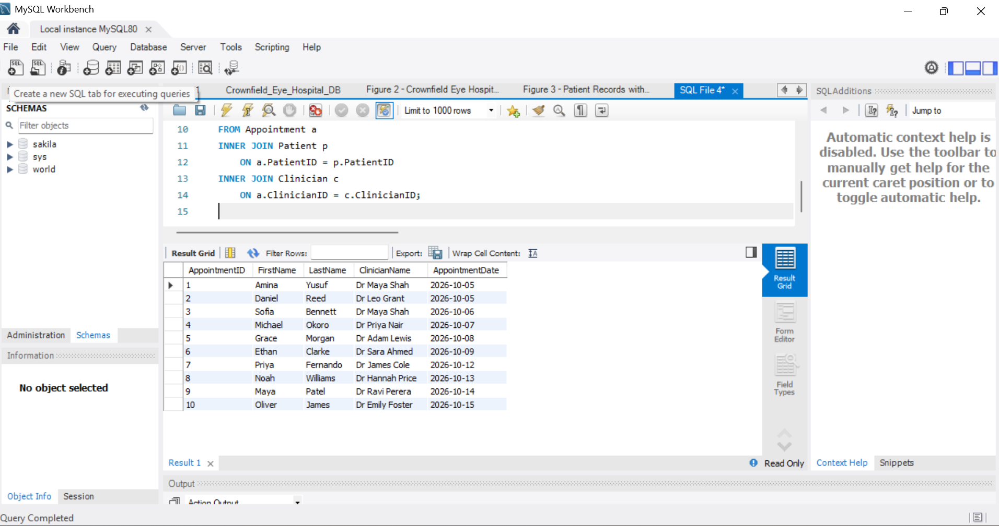
SQL example 1: INNER JOIN
• Links Patient, Appointment and Clinician
• Shows related details in one result
• Patient, appointment and clinician results
• Three-table query with matching records
Project evidence: INNER JOIN result
Notes:
This is the INNER JOIN query from our Crownfield project evidence. It connects Appointment to Patient using PatientID and to Clinician using ClinicianID. It returns the appointment ID, patient first and last name, clinician name and appointment date. I can point to the two INNER JOIN lines and one result row. The separate INNER JOIN SQL file in our evidence folder matches this demonstration.

Slide 10
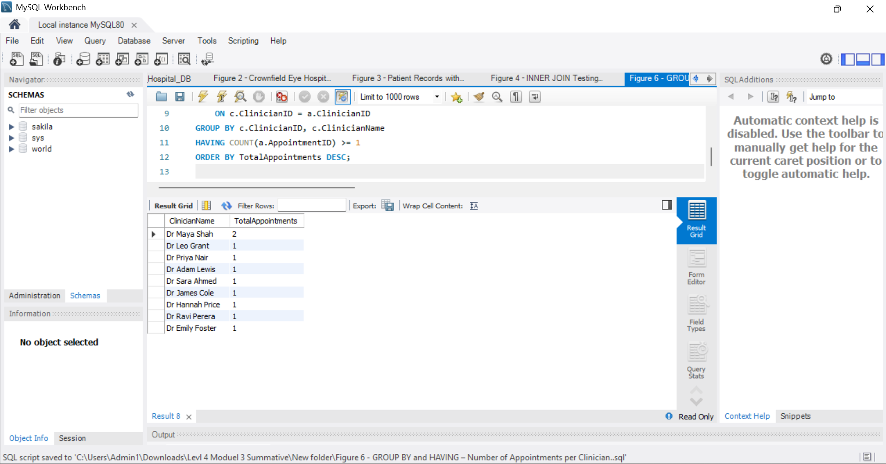
SQL example 2: GROUP BY and HAVING
• Counts appointments per clinician
• GROUP BY creates clinician groups
• HAVING filters the grouped results
• Filters counts after grouping
Project evidence: GROUP BY / HAVING result
Notes:
This is our GROUP BY and HAVING demonstration. The query joins Clinician and Appointment, counts appointments for each clinician and uses HAVING to keep groups with at least one appointment. GROUP BY makes groups; HAVING checks the totals after grouping. I will point to COUNT, GROUP BY, HAVING and a result count. The separate GROUP BY SQL file matches this example; the older combined query file uses a different version.

Slide 11
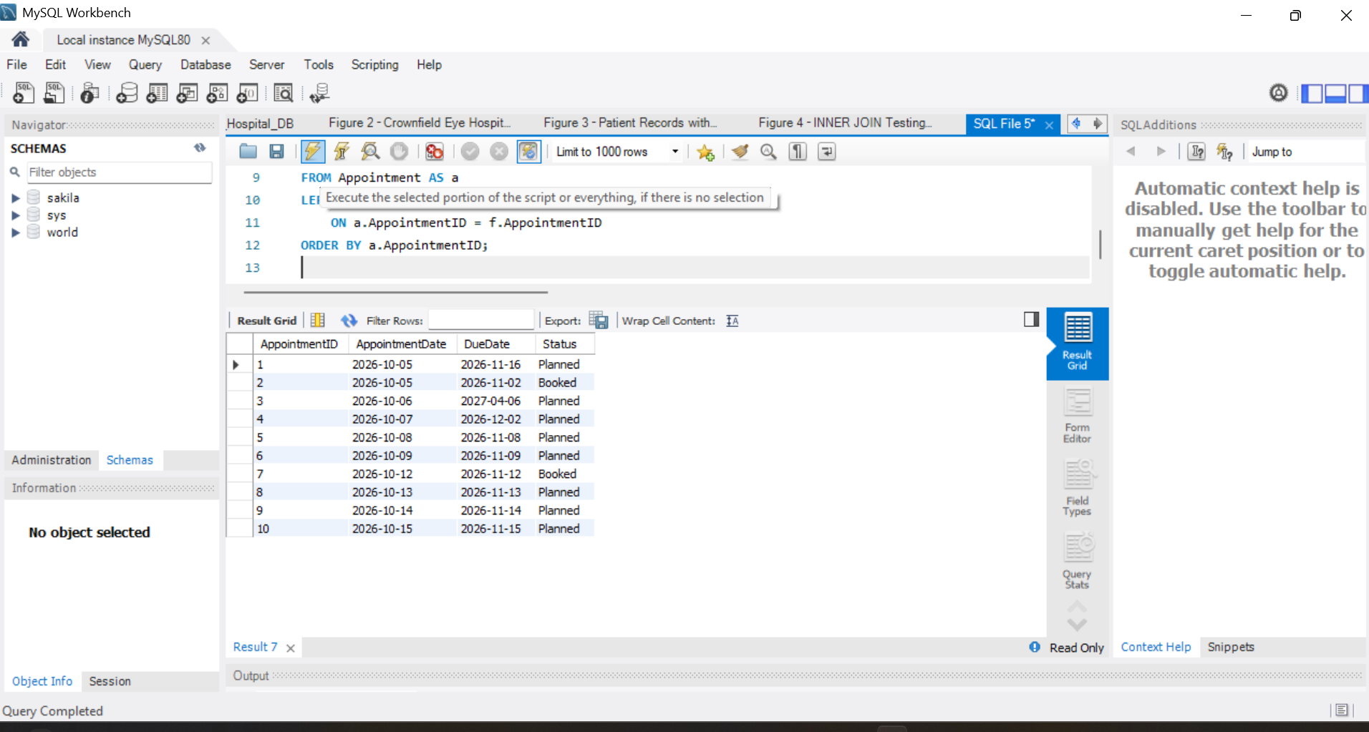
SQL example 3: LEFT JOIN
Appointment and FollowUpPlan • Includes appointments without follow-ups • Optional relationship
Notes:
This is the LEFT JOIN between Appointment and FollowUpPlan from our separate SQL evidence file. It shows all appointments, including those without a follow-up plan. When there is no follow-up, the columns from FollowUpPlan contain NULL. I will point to the LEFT JOIN and a result row without a follow-up. The older combined SQL file has a different LEFT JOIN, so this slide should be supported by the separate figure-specific file.

Slide 12
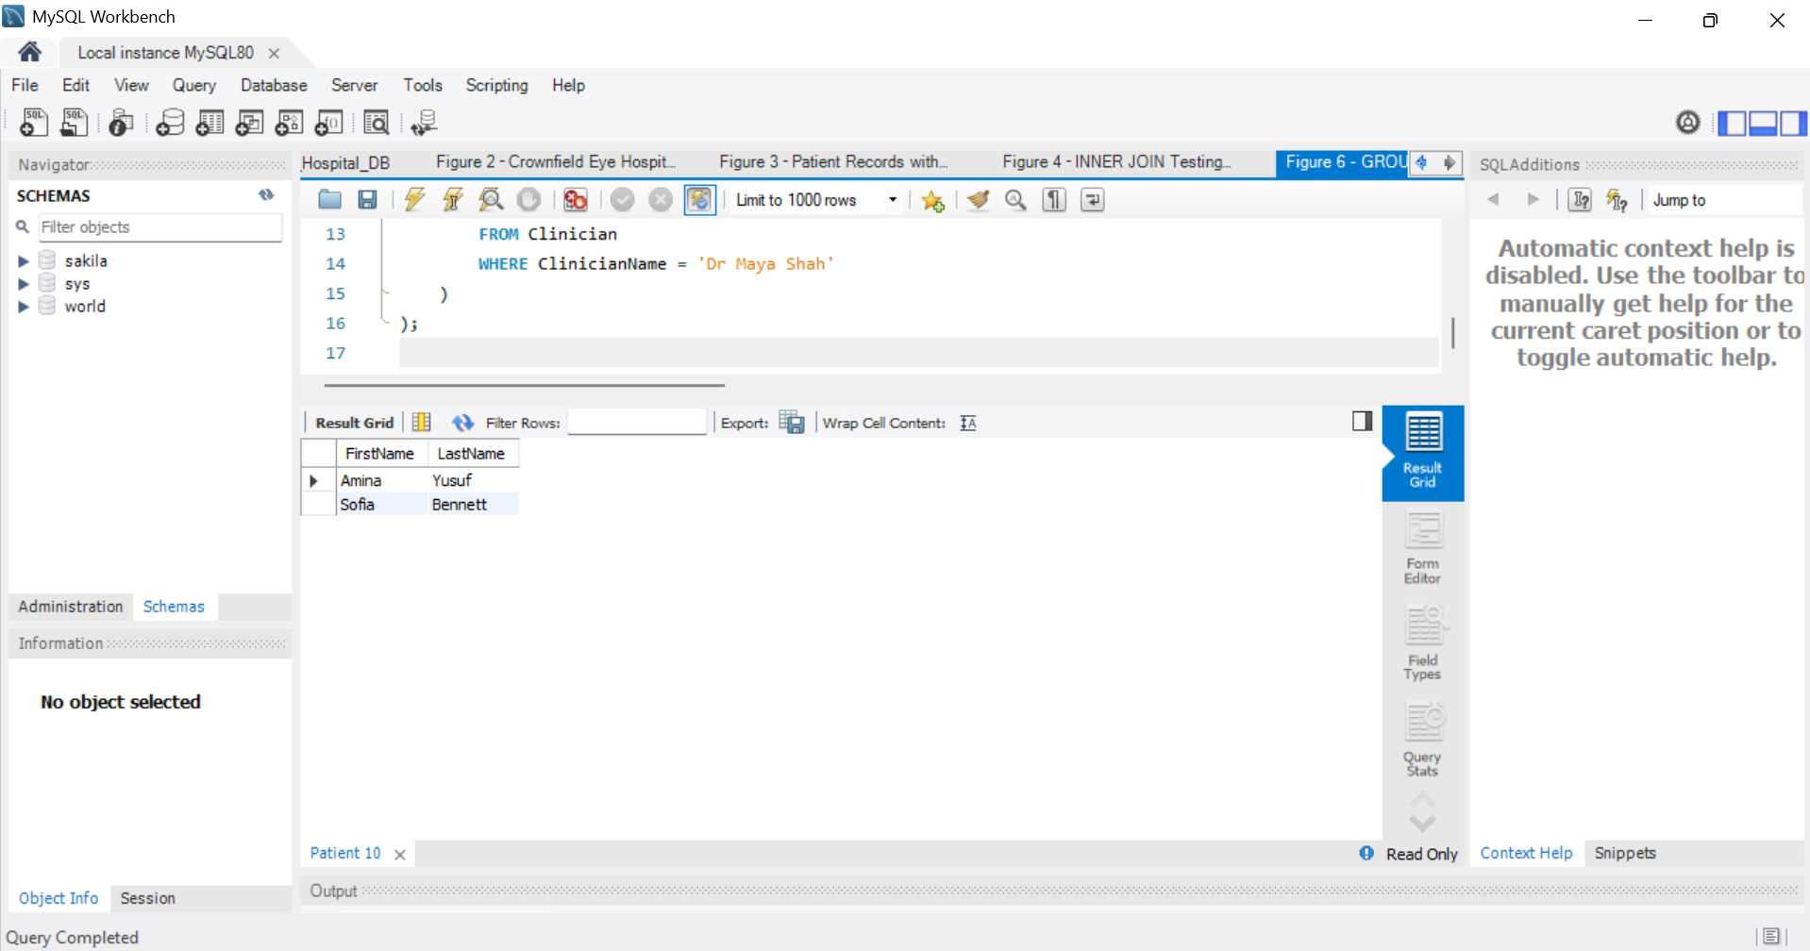
SQL example 4: Subquery
Patients who saw Dr Maya Shah • Nested query finds the clinician • Outer query returns matching patients
Notes:
This subquery finds patients who had an appointment with Dr Maya Shah. The innermost SELECT finds the clinician ID, the middle SELECT finds patient IDs for that clinician, and the outer SELECT returns patient first and last names. I will point to each SELECT and the results. This demonstration matches the separate Dr Maya Shah SQL file, rather than the broader subquery in the older combined file.

Slide 13
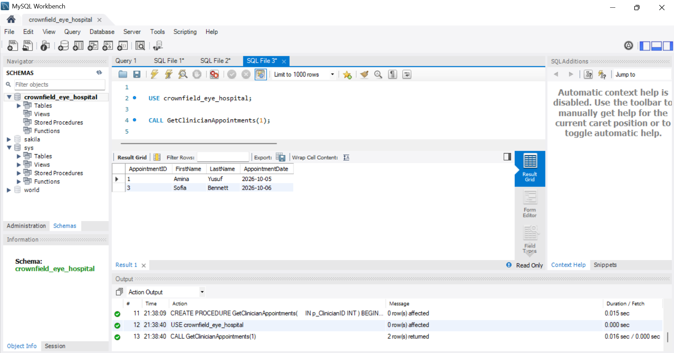
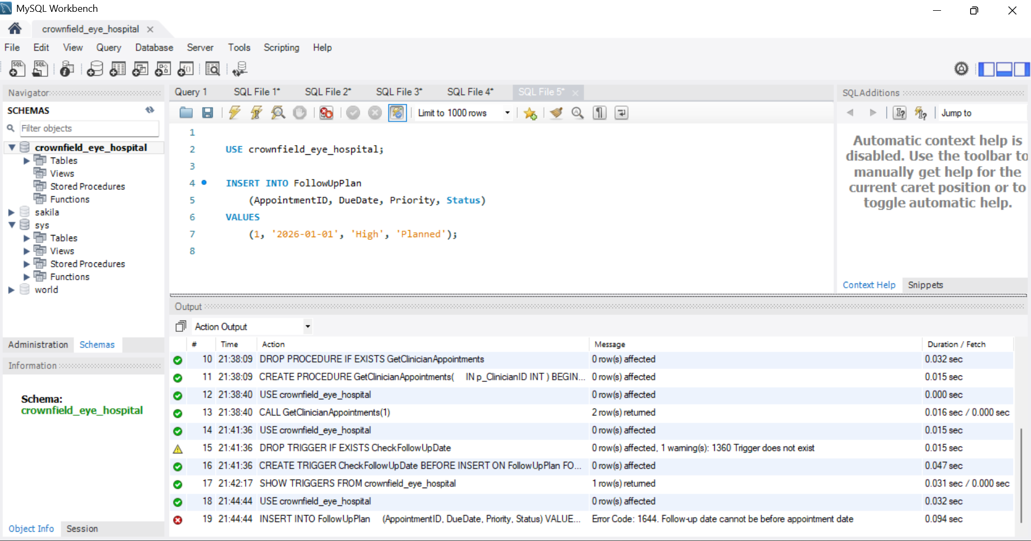
Stored procedure and trigger
• Procedure: GetClinicianAppointments
• Input: clinician identifier
• Trigger: rejects invalid follow-up date
• Actual testing screenshots
Project evidence: procedure and trigger tests
Notes:
The first screenshot shows our GetClinicianAppointments stored procedure test. It accepts a clinician ID and returns appointment IDs, patient names and appointment dates. I will point to CALL GetClinicianAppointments and the returned rows. The second screenshot shows our CheckFollowUpDate trigger rejecting a due date earlier than its appointment date. I will point to the MySQL error. Important repository check: the older combined '03 individual queries.sql' creates GetPatientAppointments instead, so the procedure definition matching this screenshot must be included in the final SQL submission. These are project demonstrations; the screenshots do not identify the original author.

Slide 14
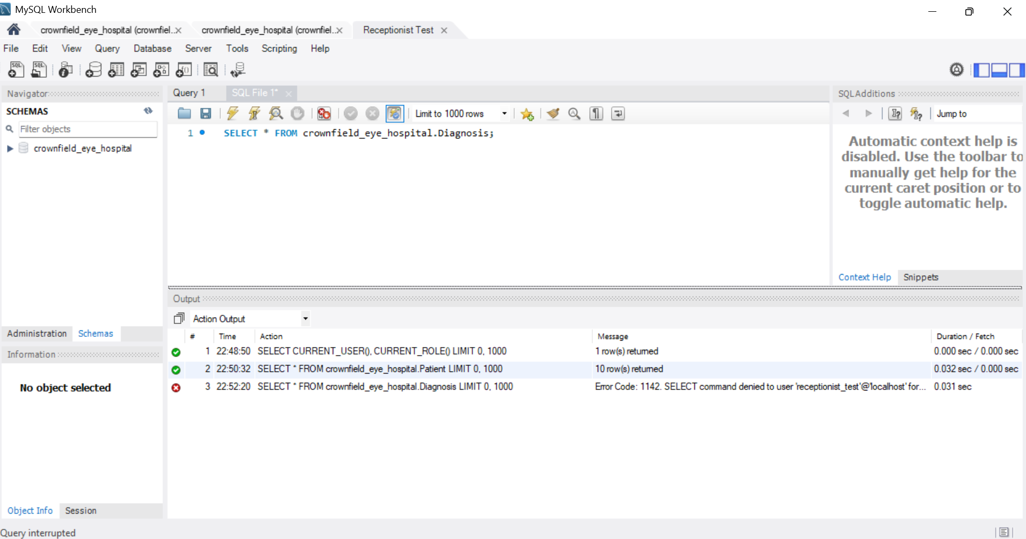
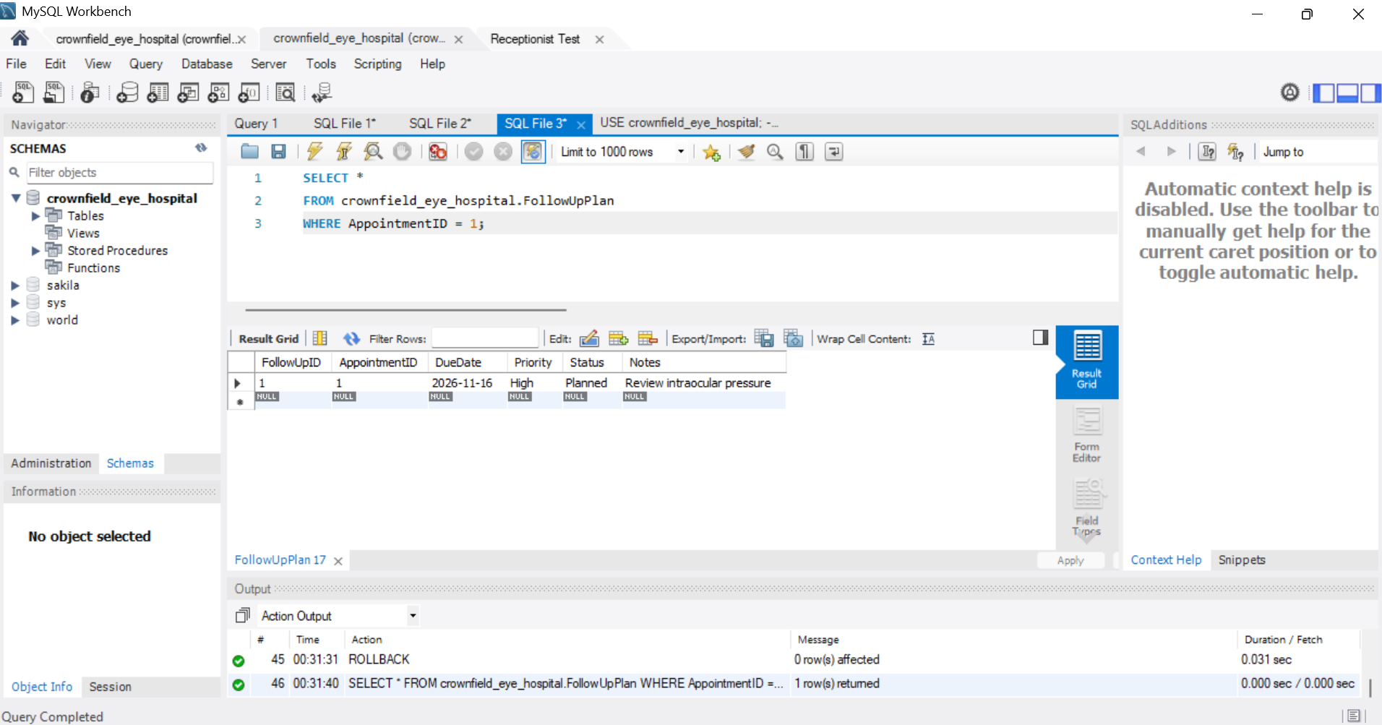
Security and transactions
• Role permissions: receptionist denied diagnosis access
• ROLLBACK restores uncommitted postcode change
• COMMIT saves a completed transaction
• Receptionist denied diagnosis access
• Access depends on responsibilities
• Do not show account passwords
Notes:
Our group designed four access roles: Administrator, Doctor, Receptionist and Patient. The left screenshot shows the receptionist access-denied test for diagnosis data, which demonstrates least privilege. On the right, the transaction screenshot shows a fictional patient postcode restored after ROLLBACK. COMMIT saves completed changes, while ROLLBACK cancels changes not yet committed. My main learning was choosing tables, keys and relationships and organising the evidence. We used fictional patient data only.

Slide 15
References and evidence check
• Connolly & Begg (2015) – database design
• Microsoft (n.d.) – normalisation
• Oracle (2024) – MySQL documentation
• NIST (2020) – access control
Notes:
The presentation covers our 11-table ER diagram, UNF to 3NF, implementation, six SQL demonstrations, security and transactions. The INNER JOIN, LEFT JOIN, GROUP BY/HAVING and Dr Maya Shah subquery match their separate figure-specific SQL files in our evidence folder. The stored procedure screenshot uses GetClinicianAppointments, while the older combined script uses GetPatientAppointments. Before uploading the SQL repository, include the matching procedure definition and keep the scripts consistent with these screenshots. This presentation describes my main contribution as ER design and the SQL evidence as project work; the files do not independently identify the author of each query. References include Connolly and Begg, Microsoft, Oracle and NIST. Thank you.

